Slide 1
Ann Nguyen & Jessica Dinh
OMIS 114 Project - Predicting how many acres will burn
Notes:
Jessica

Slide 2
How many acres will burn when a fire has occurred?
Notes:
Jessica

Slide 3
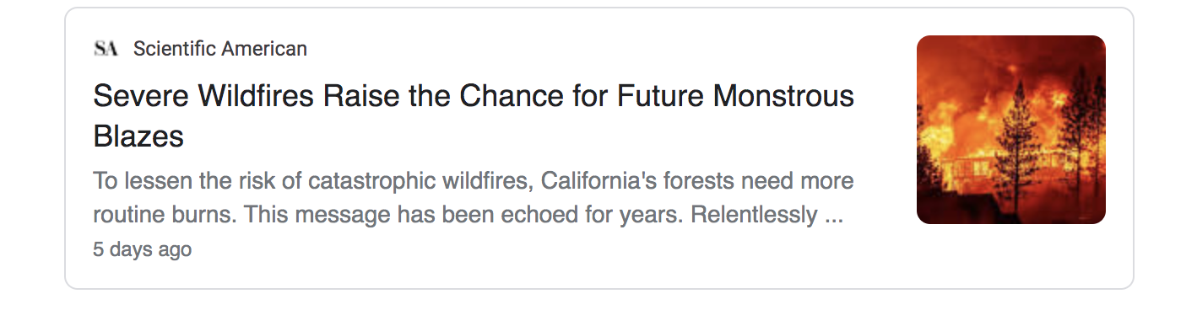
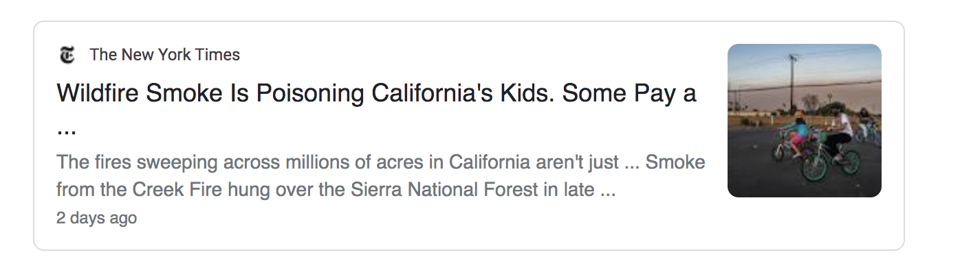
Importance
Being in CA, all these fires have impacted our lives in some aspects
Analysis could help many different groups
Residences in community
Firefighters
People near area (air quality)
Notes:
Ann
This research question was important to explore because more recently, all these fires have impacted our lives in some aspects, even from far away. For example, Southern California forest fires have wreaked havoc on the air quality by releasing smoke to not only immediate cities and counties near where the fire occurred, but also traveling to Northern California, polluting the air quality here. The analysis on our data could help many different groups of people for any forest fires that may occur in the future. Firstly, it could help the residence in the community prepare a fire evaluation kit along with having a plan of action for when it might occur. Secondly, it could help firefighters not be overwhelmed by the sudden panic of fires and allow them to have a faster response time to get to those places. This will lead to less acres of fire burning and being able to contain it before it becomes too big or widespread. Lastly, because firefighters may be able to contain the fires, it can lead to improvement of quality of life, since less people would have to evacuate and better air quality, since less acres of fire are burned. Overall, because of these predictions, the environment and well being of residents in this state will benefit from our project.

Slide 4
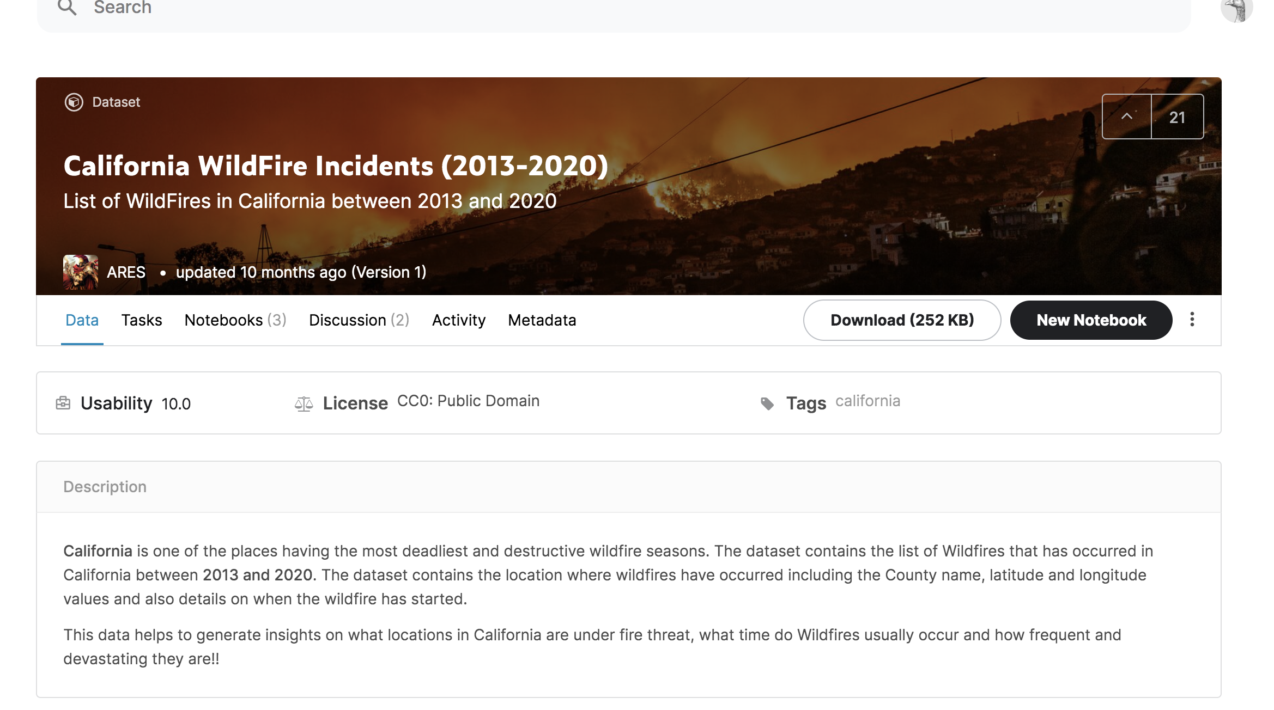
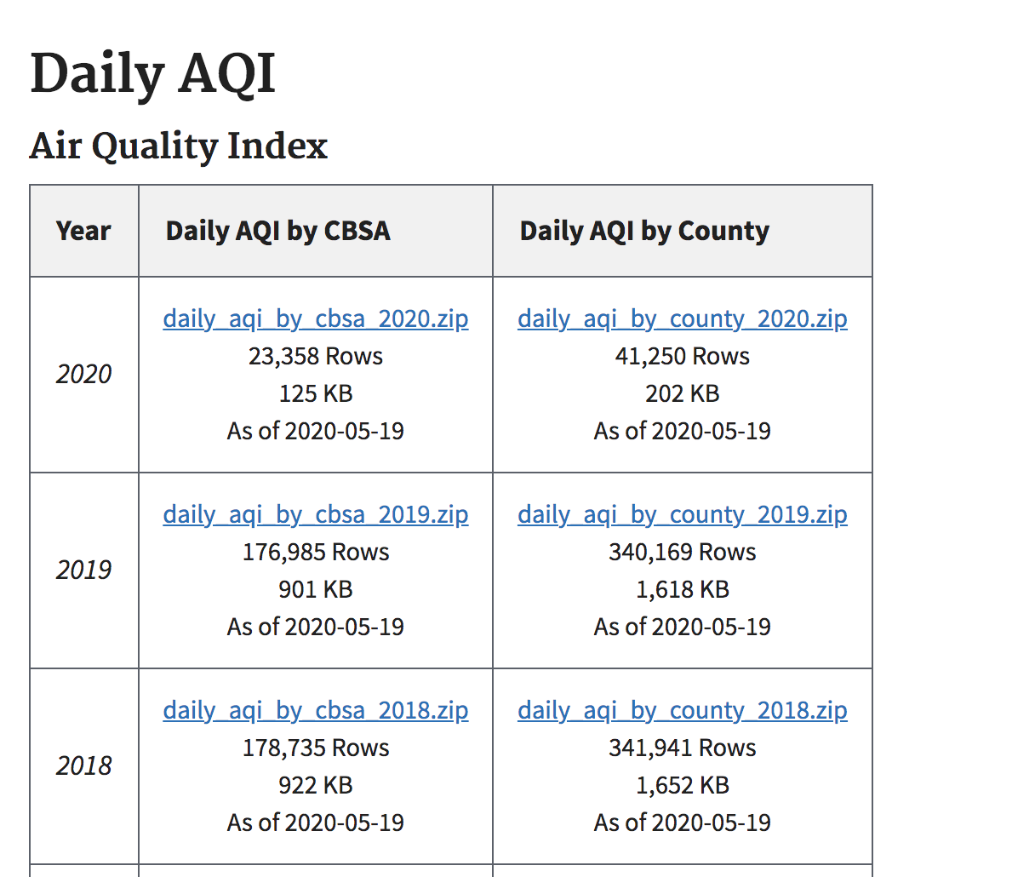
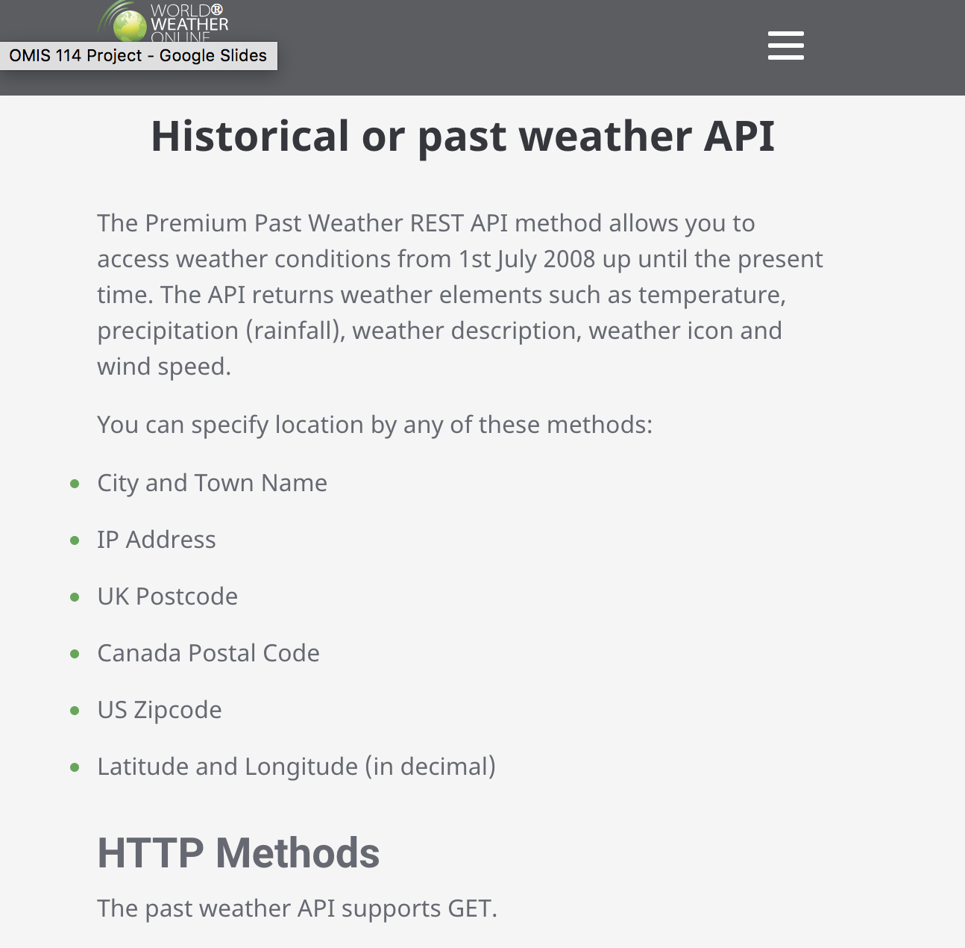
Datasets
CA fires from 2013-2020 from Kaggle
Air quality from 2013-2020 from United States Environmental Protection Agency
Weather Data from Historical Weather API from World Weather Online
Notes:
Jessica
The datasets we collected to answer our research questions are: the california fires from 2013-2020, the air quality, and the weather which contains temperature, windspeed, pressure, etc

Slide 5
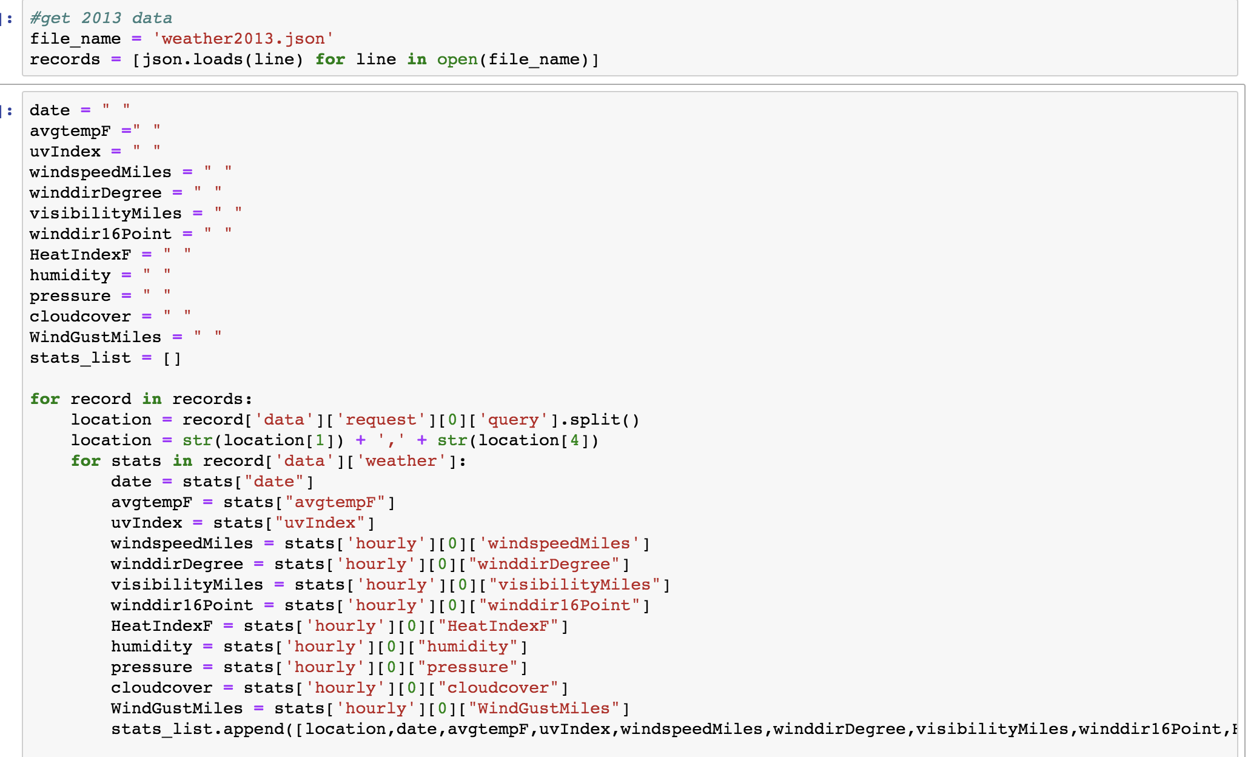
Creating Data Frames
CSV to pandas dataframe
Extracting info from API into a list to convert to pandas dataframe
Notes:
Ann
Since the air quality information and california fires were in csv format we easily converted them into a dataframe through the convert csv to panadas dataframe method.
For the weather API, it was not as easy to convert to a data frame as those datasets. Let me just go through this code with all of you and explain how we did in order to extract information and turn it into a data frame. A block of code we did not include was actually extracting information on the API using the locations from the ca_fire dataframe and turning into a json file. After that the first block of code on the top that you see is reading the json file in order to extract specific information that we needed. Next we created empty string variables just to define the variables and we created a for loop to extract the specific information such as data, average temperature F, wind speed and so on. After extracting all of it, we appended in to our stats list and this would just iterate through every record that was in the JSON file. As we can see, this block of code only did this for 2013 so we ran this code for 2014- 2020 as well. After we had our list of lists, we were able to easily convert this list of lists to a dataframe using pd.dataframe method called weatherapi

Slide 6
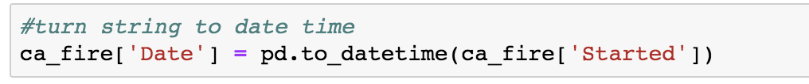
Cleaning Data
CA fire dataframe
Changed “Date” attribute type from object to datetime64
Air Quality dataframe
Find all rows with “State Code” attribute equal to 6
Notes:
Jessica
In the fire dataframe, We changed the types of the dates from objects to datetime for consistency and combined the latitude and longitude columns together
Also dropped some columns we found to be not relevant with answering our questions
In the air quality dataframe, it contained all states in the US, so we filtered the data so it can only contain california, which is state code 6

Slide 7
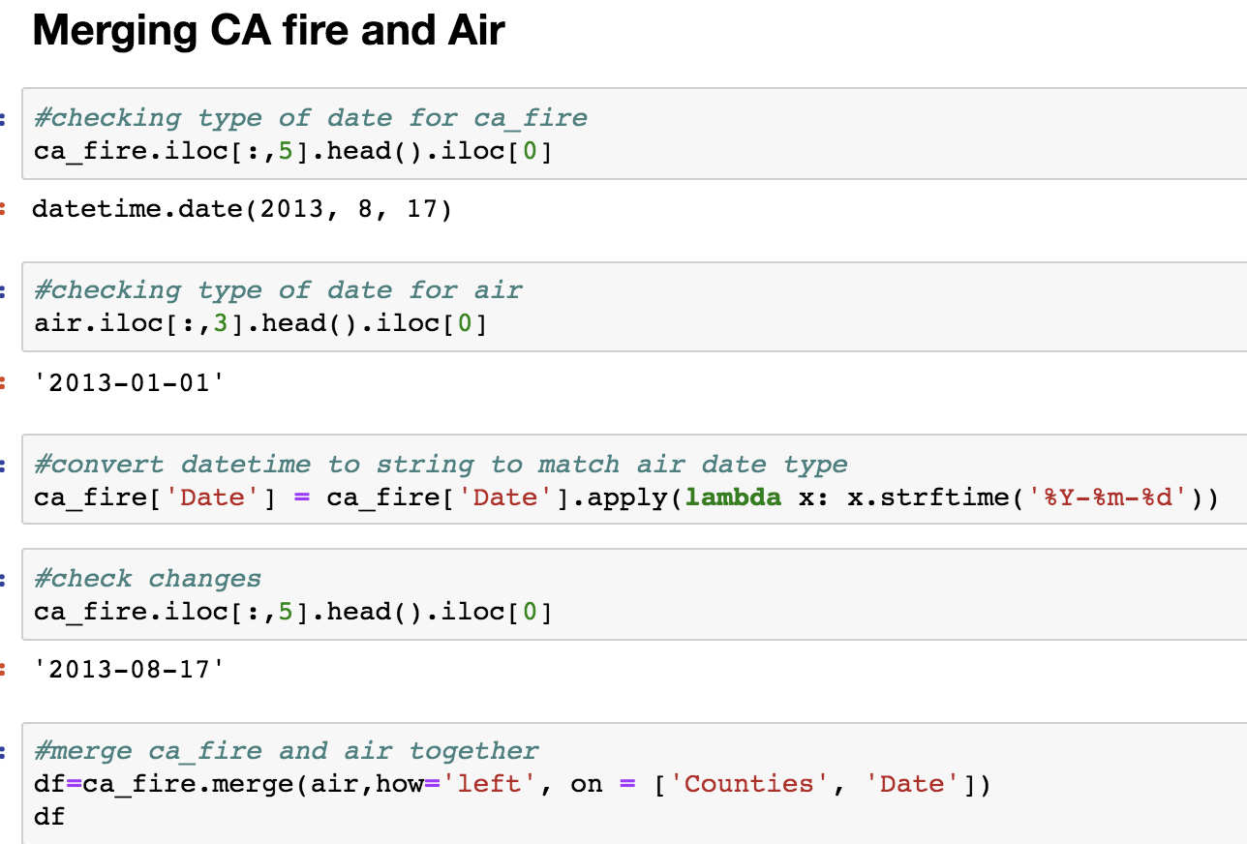
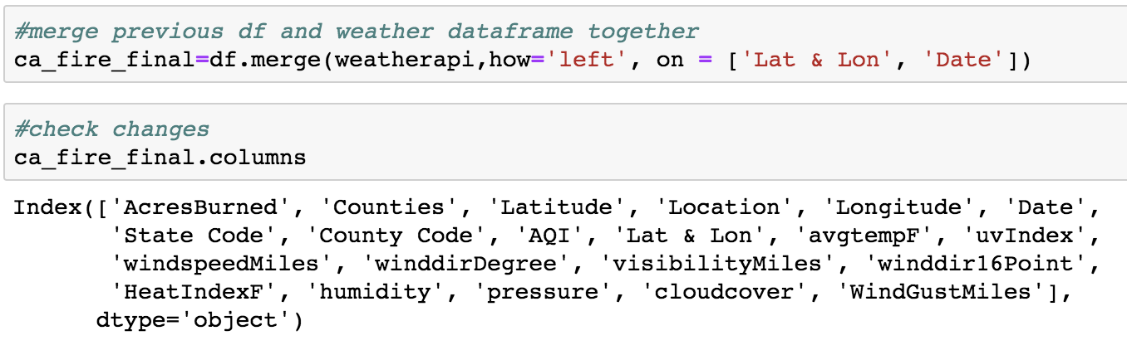
Merging Data for Final Dataframe
Left join for CA fire and Air dataframe
Left join for Weather and df dataframe
Notes:
Ann
To get one single final data frame, we first merged the CA fire and air data frame. We realized since we changed the type for date from the CA fire dataframe to date type we couldnt merge it to air because the date for that data frame was a string. So converted the date for the CA fire dataframe back to a string. We then were able to left join it on the attributes counties and date and called it df. The reason we did left join was because we only wanted the rows from the CA fire data frame.
We also left joined the df dataframe we had just created with the weatherapi dataframe we created and called it ca_fire_final. Here we can see that we have all the columns we need for our analysis

Slide 8
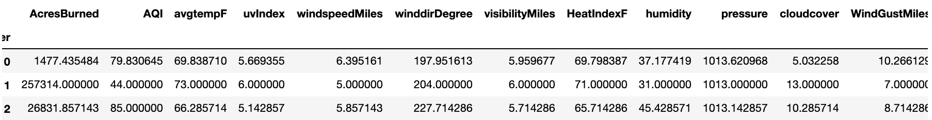
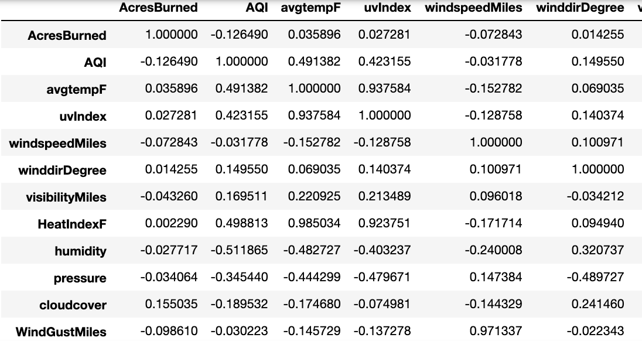
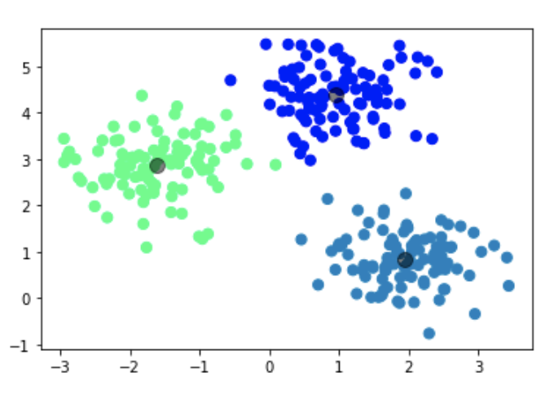
Clustering Analysis
k=3
Correlation Graph
Notes:
Jessica
For our clustering analysis, we decided to look at the correlation when doing a KMeans clustering with k=3 to see the top three areas tht has the most acres burneed. This allows us to take our data frame as an input and returns clusters that new data points belong to, identifying the major hotspots and how many acres were burned when the fire happened.
Here is a table when we grouped the clusters and their correlation
Almost, if not all have a positive and negative correlation close to 0, so there is a very small correlation between the number of acres burned with the weather.
This is a graph that represents our analysis of kmeans with k=3. As you can see, there are 3 clusters, and the grey circle is the “center” of each of them.
This shows that

Slide 9
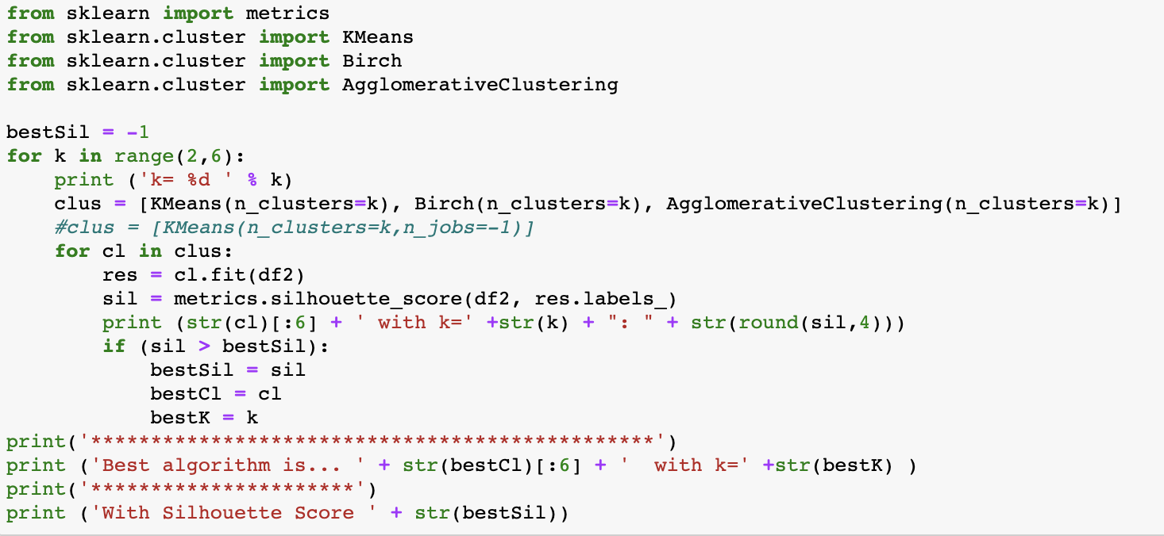
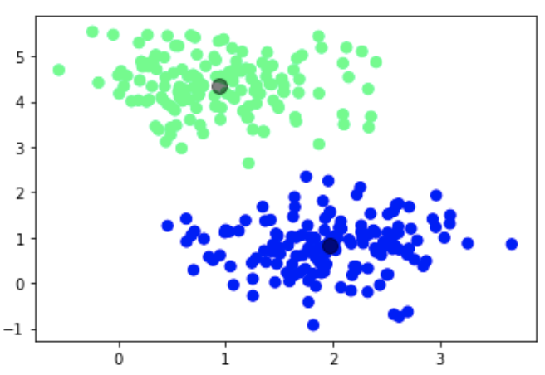
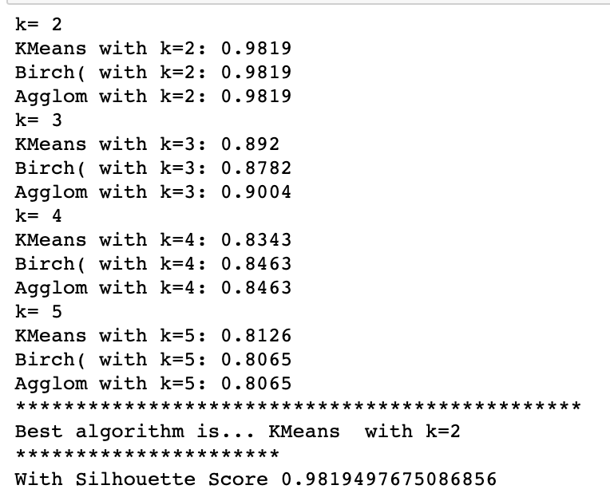
Clustering Analysis - Prediction
Best alg: Kmeans with k=2
Silhouette Score: 0.9819
Notes:
Jessica
Running the code to find the best technique for clustering we get Kmeans with k=2 and a silhouette score of 0.98
Implies that each object we have matches its own cluster and matches poorly with its neighboring cluster
represents how our data sample is far away from the neighboring cluster
We took 300 samples and a n_cluster or k of 2 and graphed it to see what it would look like

Slide 10
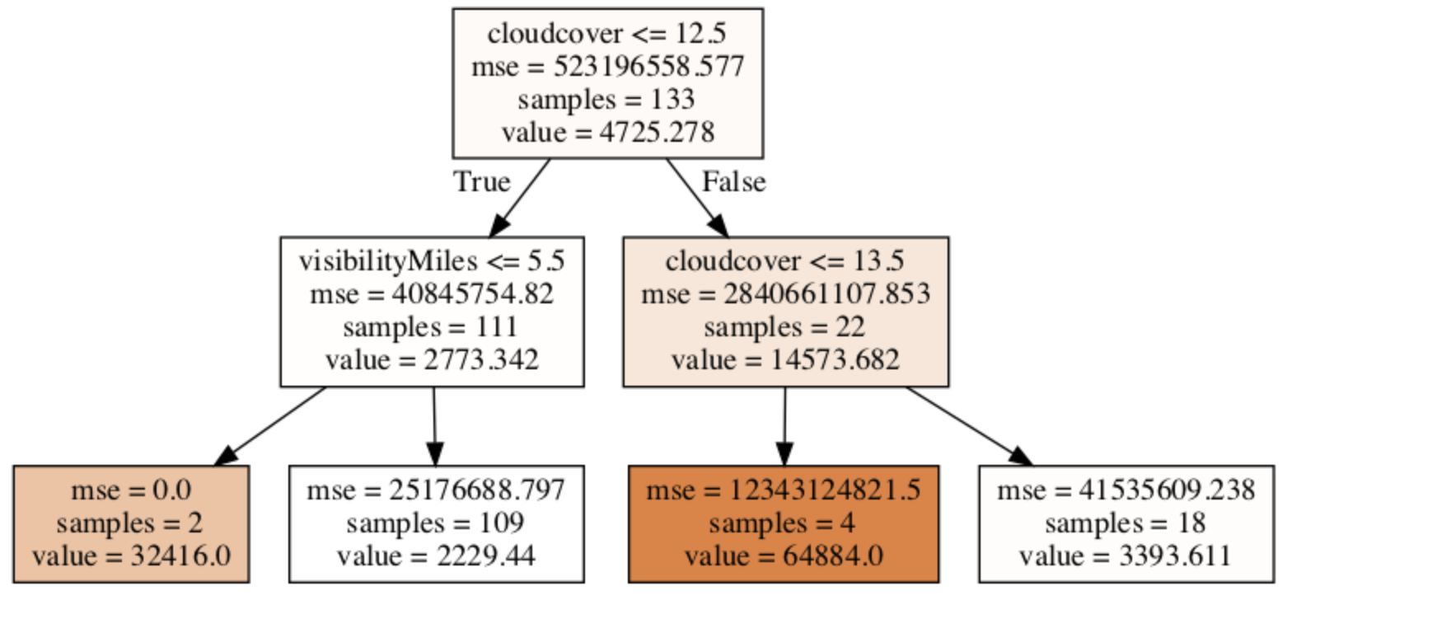
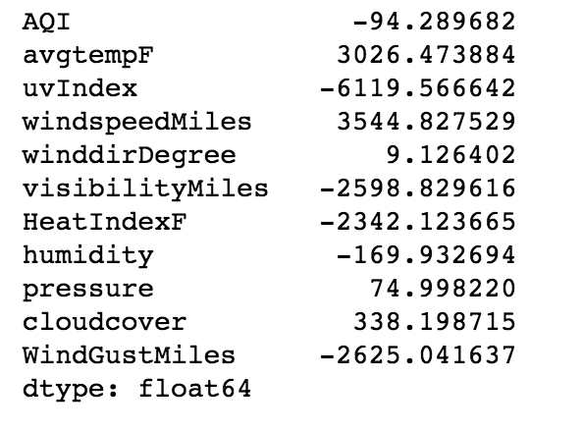
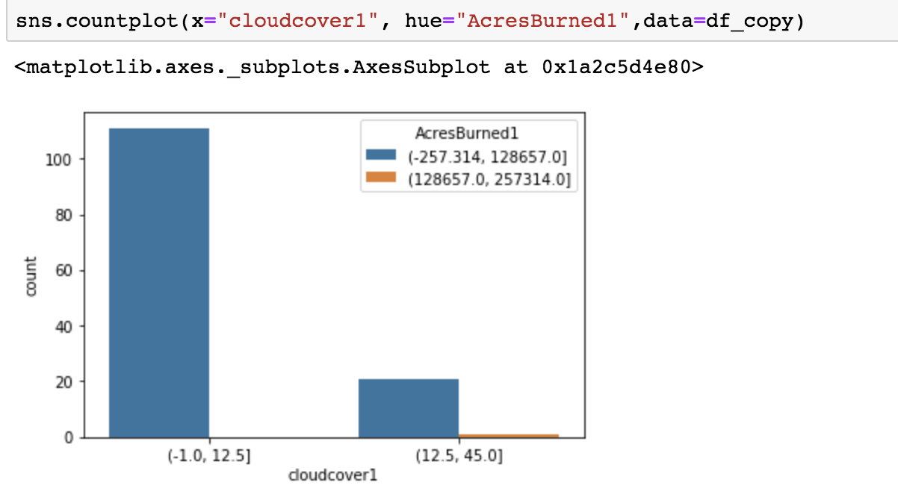
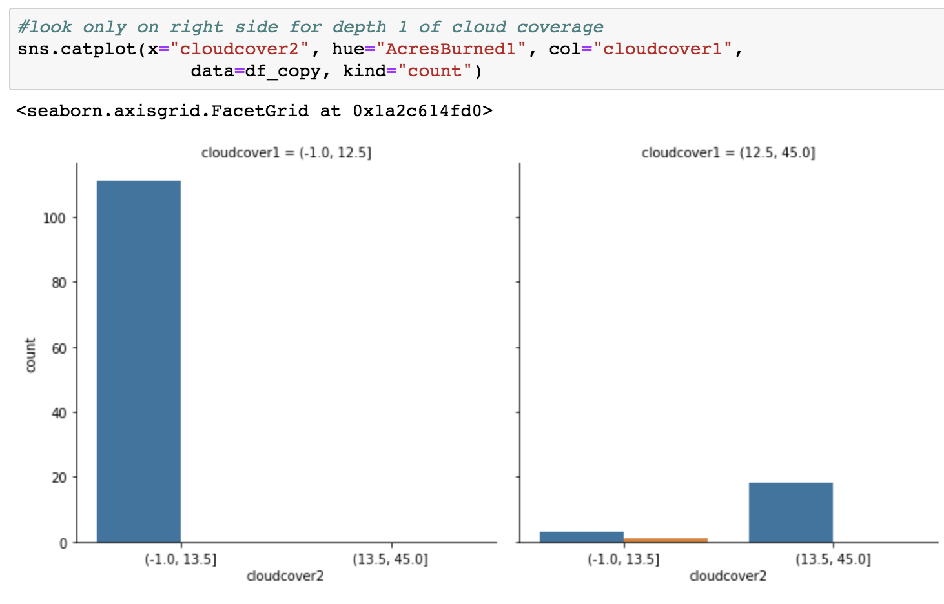
Regression Analysis - Data Exploration
Decision Tree Regressor
Lasso Coefficients
Count Plot
Count Plot
Notes:
Ann
For data exploration, we decided to find the Lasso coeffcieints on the left. We see that the most important attributes are the largest numbers (considering their absolute values), so these are f avgtempF, uvIndex, windspeedMiles, visibilityMiles, HeatIndexF, and WindGustMiles. We also did a decision tree regressor on the right. So to go through our decision tree this first layer, depth 0, tells us that the data was split first by cloud cover that is under 12.5. If that holds true for the row, it will be grouped on the left side and if not, it will be on the right side. Starting from the left side, we see in depth 1, 111 samples/rows have cloud cover less than 12.5 and the average Acres Burned is 2773.342 (as seen by value). Our MSE (mean square error) is a higher number, which tells us that the difference between the estimated values and the actual value is large. Although it is relatively large, it would be plausible that our MSE is high because acres burned for a fire in our dataset is typically in the thousands, which causes our mean square error to be large. Because of this, our model could be reliable based on the dataset. Going down to depth 2, we see that 2 samples have less than visibilityMiles of 5.5 and with MSE of 0, which means there is no error and it has predicted the true value. Samples that are below or equal to cloud coverage of 12.5 and visibility miles below equal to 5.5 will have fire that will burn for, on average, 32,416 acres. On the right side of the decision tree, we see in depth 1, 22 rows are above cloud coverage of 12.5. The average acres burned for fires that have above cloud coverage of 12.5 is 14,573.682. The MSE being also large for our dataset still tells us that this could be accurate. Moving down to depth 2, we see that 4 samples are below or equal to cloud coverage of 13.5 (while also being above or equal to 12.5). The average acre burned for this criteria is 64,884. For cloud coverage above or equal 13.5, there are 18 rows and the average acres burned is 3,393.611.
I decided to use count plots to have a better grasp of our decision tree. As i mentioned with the decision tree, 111 samples have cloud coverage less than 12.5 and 22 samples have cloud coverage of more than 12.5, which is what we see on the left count plot. Just to preface i decided to split the acres burned into 2 bins because it would be easier to read so that there arent multple column and too many numbers that we would be hard to read. On the right countplot we are only look at the right side because we are only looking at the cloud coverage that is more than 12.5 and on the X- axis cloud coverage more than 13.5. So we see that cloud coverage less than 13.5 (but more than 12.5) has 4 samples, and more than 13.5 has 18 samples.

Slide 11
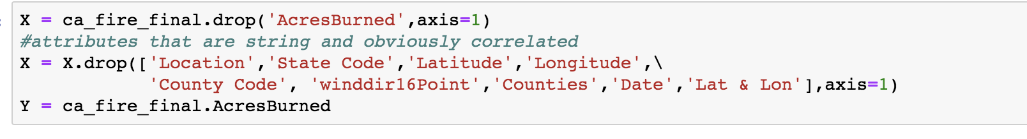
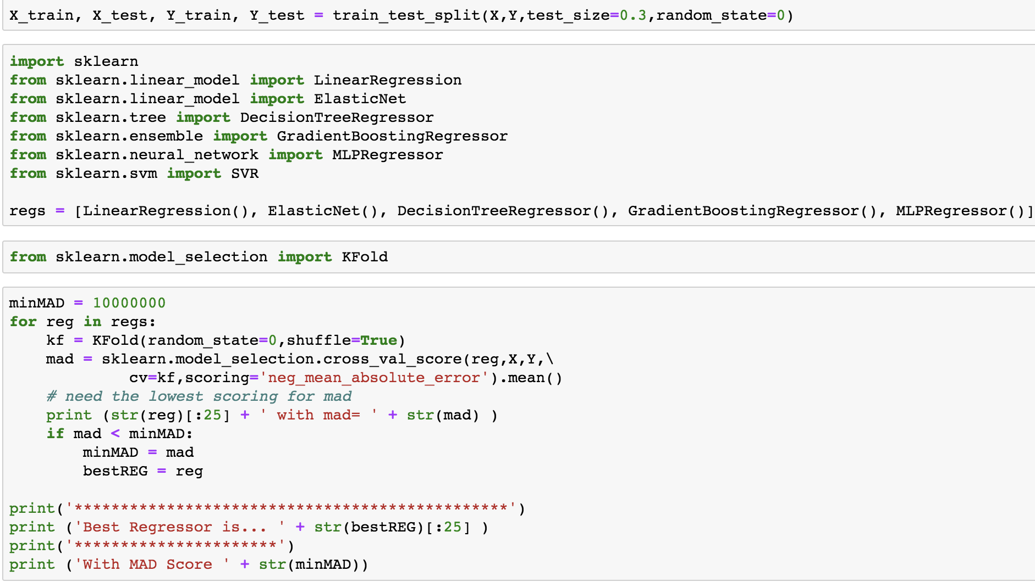
Regression Analysis - Prediction
Best Regressor Linear Prediction with MAD score -9378.32
Notes:
Ann
For prediction we were able to find the best regressor for our data which was Linear Regression with a MAD score of -9378.32. This means that there is less variability in the data. It implies that the mean of acres burned in the dataset is indicative of the other values within the data set.
The first bullet point with code shows which attributes we used for our prediction and the target attribute/variable which is acres burned because we want to predict how many acres will burn.
And the second bullet point of code shows the how we were able to find our best regressor. With that being said that concludes the end of our presentation

Slide 12
Thank you!
Any questions?
Notes:
Ann

